Slide 1
The characteristics of embedded systems are as follows:
It has certain processing capabilities.
It reacts to the input taken from the environment.
It responds with processed data.

Slide 2
Any device that has in-built processing power with certain input and output capability and has certain memory built-in is a very generic way of defining an embedded system.

Slide 3
A system is a block with known behavior and has processing capability for a given input and generating desired output. A system can be further divided into a number of subsystems where each subsystem itself is a system. It is a typical hierarchical definition of a system.
An embedded system is an electronic system that contains at least one controlling device, i.e. “the brain”, but in such a way that it is hidden from the end user. That is, the controller is embedded so far in the system that usually users don’t realize its presence.

Slide 4
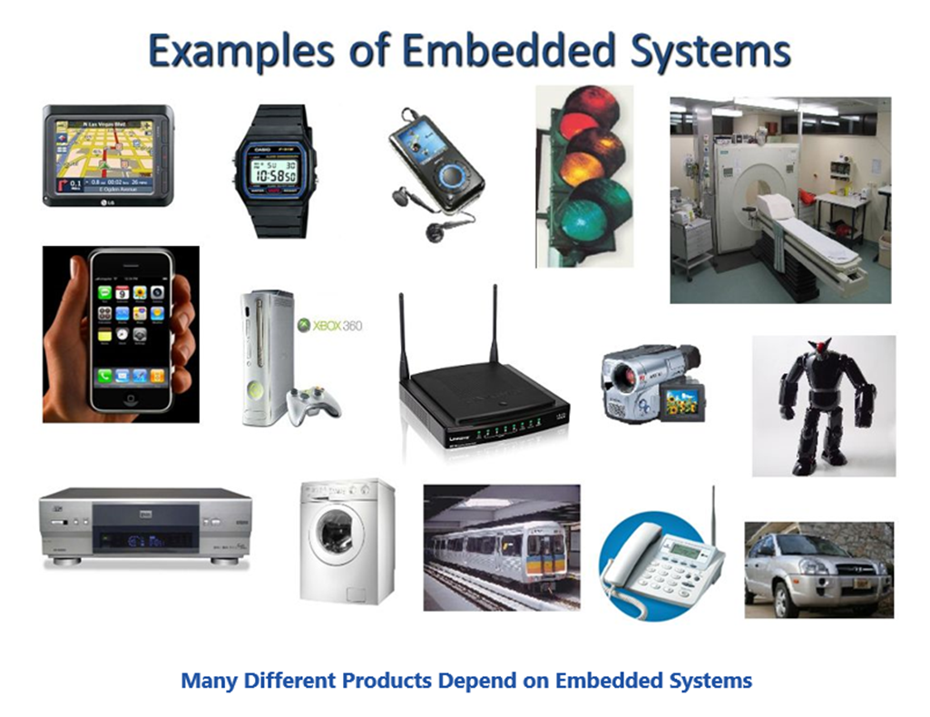

Slide 5
The embedded systems Common Characteristics:
Unique functionality.
User-driven requirements.
Energy-efficient.
Compact.
Response time.
Reactive.
Real time (It means that the output must be available at a stipulated time).

Slide 6
Some Quality Metrics in ES Design:
Non-recurring engineering costs (NRE).
Unit cost.
Performance.
Energy efficiency.
Functional updates.
User interface.
Size.

Slide 7
Maintainability.
Ruggedness (recovery from unexpected conditions, correctness in measurements in harsh environments).
Trueness.
Safety.
Optimizations needed.
Time-to-market.

Slide 9
Versatility Factors for ES Product
The versatility of an Embedded System (ES) product is determined by key qualitative parameters, including:
Speed.
More features.
Openness.
Expandability.
Customizability.
Upgradability.
Modularity.

Slide 10
Graceful degradation.
The accuracy.
Smart systems.
Ubiquity.
Machine intelligence.
Context-aware - refers to a system's ability to sense, interpret, and respond to its environment dynamically.

Slide 11
Technologies Involved:
Processors.
General-purpose processors.
Custom processors.
Application-specific processors (digital signal processors and microcontrollers)

Slide 12
Platforms.
Dedicated systems.
Bus-based systems.
Distributed systems.
Devices-IC Technology.

Slide 13
Hardware/Software Co-design
Another major decision that a designer has to take is whether the task has to be implemented through software programming or implementing the logic in hardware.

Slide 14
Microcontroller | Microprocessor
A microcontroller is the heart of an embedded system | A microprocessor is the heart of a computer system
All peripherals are embedded into a single chip | All peripherals need to to connected separately
The circuit can be simple and compact | The circuit is complex and bulky
Low power consumption | High power consumption
Single voltage power rail is enough | Different voltage power rail is required
Uses flash memory to execute programs | Uses external RAM to execute programs
Can be used in a compact system and hence efficient | Can not be used in a compact system and hence not efficient
The input and output is defined | The input and output is not defined
Cost of the system is low | Cost of the system is higher than microcontrollers
Used in refrigerators, washing machines | Used in personal computers, mobile phones

Slide 15
Raspberry Pi |  | Arduino
Raspberry Pi is a Single Board Computer or SBC |  | Arduino is a Microcontroller based development board
A Debian based Linux Distribution called Raspberry Pi OS is needed to boot the Raspberry Pi |  | As it is a Microcontroller, there is no need for an operating system
Raspberry Pi SBC can preform multiple tasks simultaneously due to its powerful processor and Linux based OS. |  | Arduino is usually used for running a single task (or a very small no. of simple tasks) repeatedly, over and over again
All the necessary components like Processor, RAM, Storage, Connectors, GPIO Pins, etc. are situated on the Raspberry Pi Board itself |  | The Microcontroller on the Arduino Board (like ATmega328P) contains the Processor, RAM, ROM. The board contains supporting hardware (for power and data) and GPIO Pins

Slide 16
Both the hardware and firmware of Raspberry Pi are closed-source i.e., it is not available for general use |  | Arduino is developed as open-source hardware and software from the beginning. You can easily get complete information on Arduino’s hardware and software
Raspberry Pi SBC has several GPIO Pins (the famous 40-pin Raspberry Pi GPIO), using which you can connect different sensors, IO Devices, etc. |  | GPIO is an important peripheral of any Microcontroller and Arduino UNO is no exception. In Arduino terminology, these pins are called Digital IO (to connect LEDs and Buttons) and Analog IN (to connect analog devices)
Using the 40-pin GPIO Pins, you can add additional features / functionalities to Raspberry Pi with HAT (Hardware Attached on Top) expansion boards |  | A similar way to add extra features and functionalities in Arduino is using Arduino Shields (which are also connected through the IO Pins)
As Raspberry Pi is essentially a computer, you have to properly shutdown after using it or before powering it down. |  | As Arduino is a Microcontroller board, you can plug and unplug the power as you want.

Slide 17
The main programming languages for developing application in Raspberry Pi are Python, Scratch, Ruby, C, C++ |  | Arduino can be programmed using C or C++ Programming Languages
The logic level of Raspberry Pi’s GPIO is 3.3V. So, be careful when connecting hardware to the GPIO Pins |  | Arduino’s logic level is 5V. As most of the sensors and modules are designed for Arduino, there won’t be any problem connecting them to Arduino. But double check every module and connection just to be on the safe side
Raspberry Pi must be powered using an USB Power Adapter as it requires 5V 2A or 5V 3A power. |  | Arduino can be powered from a computer’s USB Port (make sure the USB Port’s current limit is not exceeded).
You can easily connect to internet using Wi-Fi or Ethernet. |  | For Arduino, you need additional module or shields to connect to internet
Raspberry Pi has the hardware for Bluetooth and Wi-Fi on board |  | There is no wireless connectivity in case of Arduino (at least on board)

